Slide 1
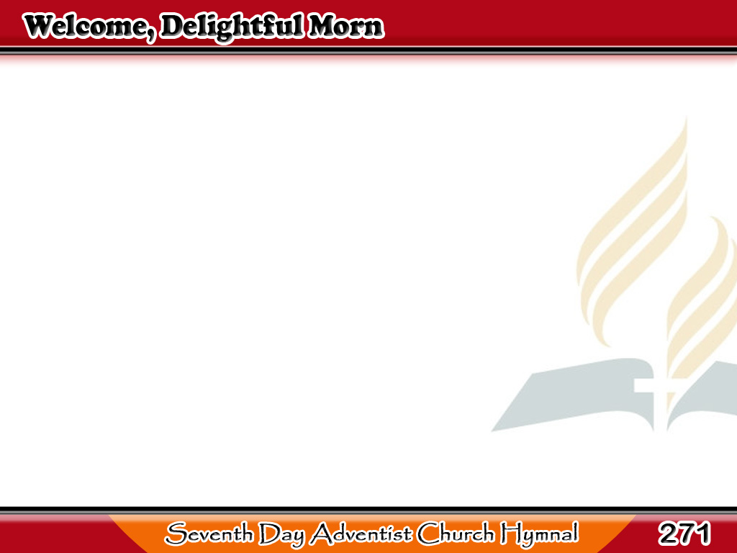
Binabati Kita
Welcome, delightful morn,
Thou day of sacred rest!
I hail thy kind return;
Lord, make these moments blest;
1/3

Slide 2
Binabati Kita
From the low plane
of mortal toys
I soar to reach immortal joys,
I soar to reach immortal joys.
1/3

Slide 3
Binabati Kita
Now may the King descend,
And fill his throne with grace;
Thy scepter, Lord, extend,
While saints address Thy face;
2/3

Slide 4
Binabati Kita
Let sinners feel
Thy quickening word,
And learn to know
and fear the Lord,
2/3

Slide 5
Binabati Kita
And learn to know
and fear the Lord.
2/3

Slide 6
Binabati Kita
Descend, celestial Dove,
With all Thy quickening powers;
Disclose a Saviour’s love,
And bless the sacred hours;
3/3

Slide 7
Binabati Kita
Then shall my soul
new life obtain,
Nor Sabbaths be enjoyed in vain,
Nor Sabbaths be enjoyed in vain.
3/3

